Slide 1
Statistics Lecture 3
Winfred Gatua
31/03/2021

Slide 2
Objectives
Probability theory
Regression and correlation
Hypothesis testing
Hidden Markov Models

Slide 3
Probability theory
Provides a framework for reasoning about likelihood of events
Experiment: a procedure that yields one of a possible set of outcomes e.g repeatedly tossing a coin/die
Sample space S: set of possible outcomes of an experiment e.g. tossing a die S=(1,2,3,4,5,6);tossing a coin S=(H,T)
Event E: set of outcomes of an experiment e.g. event that the toss is a tail
Probability of an a outcome s or p(s): a number that satisfies these two properties (i) for each outcome s,0<=p(s)<=1 (ii) summation of p(s)=1
Probability of event E: sum of the probabilities of the outcomes of the experiment: p(E)=summation E p(s)

Slide 4
Probability theory
Independence, Conditional, unconditional
Independent Events: A and B are independent if:
P(A ∩ B) = P(A)P(B)
P(A|B) = P(A)
P(B|A) = P(B)
Conditional Probability: P(A|B) = P(A,B)/P(B)
Bayes Theorem: P(A|B) = P(B|A)P(A)/P(B)
Joint Probability: P(A,B) = P(B|A)P(A)
Marginal Probability: P(A)

Slide 5
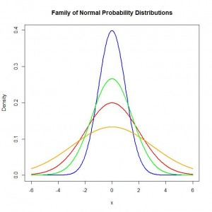
Continuous Probability distributions
A probability distribution in which the random variable X can take on any value (is continuous)
The probability that X falls between two values (a and b) equals the integral (area under the curve) from a to b.
Probability density function

Slide 6
Linear regression
Linear Regression refers to technique of fitting and studying a straight line relationship between two variables.
The process of predicting variable Y(outcome) using variable X(predictor)
𝑌 =a+b𝑋 +𝜀

Slide 7
Linear Equation

Slide 8
Assumptions
Linearity: straight line relationship between Y and X. Most easily evaluated using a scatter plot. Nonlinear patterns can show up in residual plots. Lack of fit test can be used
Constant variance: variance of residuals is assumed to be constant for all x. plot residuals vs independent variable, if they show a rectangular shape, we assume constant variance.
Normality: residuals are assumed to follow the normal distributions (check using the qqplots, Shapiro-Wilk test)
Independence: residuals are assumed to be uncorrelated with one another. This may be due to model misspecification or time sequenced data.

Slide 9
Confounding
A third variable, not the dependent (outcome) or main independent (exposure) variable of interest, that distorts the observed relationship between the exposure and outcome.

Slide 10
Dealing with confounding
Stratified Analysis (such as by age group)
Multiple linear regression (adjust for confounding)
At study design level (Randomization)

Slide 11
How confounding arises
Confounding by indication: When evaluating the effect of a particular drug, many times people who take the drug differ from those who do not according to the medical indication for which the drug is prescribed.
Selection bias: Not everyone invited to participate in a study, causing imbalance between groups.
Recall bias: Not everyone with an exposure recalls their exposure history correctly, perhaps causing uneven recall in different groups.
Many other ways, including unbalanced groups by chance, especially in smaller studies.

Slide 12
Multiple Linear Regression
An extension of a simple linear regression model.
More than one independent (predictor) variables but a single dependent(outcome) variable
Model selection (Stepwise method)

Slide 13
Collinearity
Collinearity (or multicollinearity or ill- conditioning) occurs when independent variables in a regression are so highly correlated that it becomes difficult or impossible to distinguish their individual effects on the dependent variable.

Slide 14
Effects of Collinearity
Regression coefficients will change dramatically according to whether other variables are included or excluded from the model
The standard errors of the regression coefficients will tend to be large, since the beta coefficients will not be accurately estimated.
Predictors with known, strong relationships to the response will not necessarily have their regression coefficients accurately estimated
Variance Inflation Factor(VIF)>10 causeforalarm!

Slide 15
Other types of statistical models
Repeated Measures data (Multivariate linear regression models, GEE)
Count data (Poisson, negative binomial, zero inflated etc)
Binary data (0,1) (Logistic regression, conditional logistic etc)

Slide 16
Correlation
Correlation a Linear association between two random variables
Correlation analysis show us how to determine both the nature and strength of relationship between two variables
A zero correlation indicates that there is no relationship between the variables
A correlation of –1 indicates a perfect negative correlation
A correlation of +1 indicates a perfect positive correlation

Slide 17
Continue

Slide 18
Hypothesis testing
Hypothesis- claim that you want to test or investigate using sample data
Two hypothesis:
Null hypothesis- default hypothesis, currently accepted value for a parameter, denoted as H₀
Alternative hypothesis- Researcher hypothesis, denoted as H₁

Slide 19
Steps in hypothesis testing
State hypothesis
Identify the test statistic and its probability distribution
Specify the significance level
State the decision rule
Collect the data and perform calculations
Make statistical decision
Make the economic decision

Slide 20
P-value

Slide 21
Types of errors

Slide 22
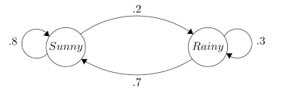
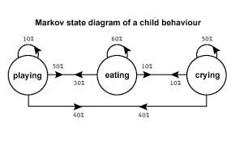
Hidden Markov models
Markov Chain: a stochastic model describing a sequence of possible events in which the probability of each event depends only on the state attained in the previous event
The chain moves state at discrete time steps
HMM entails a formal foundation for making probabilistic models of linear sequence labeling problems.
They provide a conceptual toolkit for building complex models just by drawing an intuitive picture

Slide 23
Markov Model

Slide 24
Markov Model Matrix

Slide 25
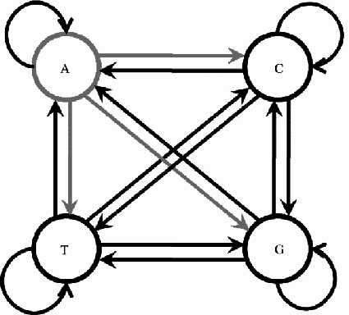
HMM in DNA

Slide 26
Computing probabilities in R
Multiple linear regression

